Slide 1
CS8382
Object Oriented Programming
Rajasekaran. S
Assistant Professor
Dept of IT

Slide 2
Course Overview
Unit 1 | INTRODUCTION TO OOP AND JAVA FUNDAMENTALS
Unit 2 | INHERITANCE AND INTERFACES
Unit 3 | EXCEPTION HANDLING AND I/O
Unit 4 | MULTITHREADING AND GENERIC PROGRAMMING
Unit 5 | EVENT DRIVEN PROGRAMMING

Slide 3
What you need?
A computer with java installed.
A decent internet connection for your reference.
Text editor of your choice.
IDE eclipse preferred.
A book that help’s you when you are in offline.

Slide 4
Object Oriented Programming
It is a software design methodology.
It is a software programming model that constructed based on objects.
It aims to implement real world entities in programming.

Slide 5
OOP Languages
The programming languages that follows the oops principles is known as object oriented programming languages.
Keep in mind every programming language is created for a purpose.
Java is on of the general purpose object oriented programming language.
Languages that follows oops principles other than java.
  Simula, C++, Python … etc

Slide 6
OBJECT
Object is specific instance of a class.
It is often referred as a “Real world Entity”.
It lives in computer memory.
It has real values.
Objects of the same class need not be a same.
Shares similarity with attributes but differs with values.

Slide 7

Example of an Object
Properties | Methods
Colour | Start, Stop
Transmission Type | Accelerate
Max Speed | Change Transmission

Slide 8
CLASS
It is template definitions of methods and variable.
Class is blue print of Object.
Class should be instantiated before using.
It is used to describe more than one object.
A class is an extensible program-code-template for creating objects.
Classes are help us to create multiple objects from them.

Slide 9
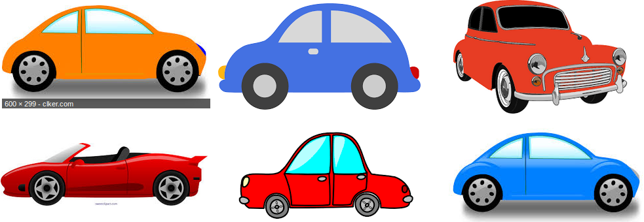
Car Class
List the differences between above cars.

Slide 10
4 Principles of OOP
Abstraction
Encapsulation
OOPS
Inheritance
Polymorphism

Slide 11
ABSTRACTION
It is used to manage the complexity of the program.
Hiding unwanted information from users.
Hiding internal working mechanism from user.

Slide 12
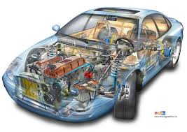
Abstract Car
How much user must know about the car for safe operations?

Slide 13
ENCAPSULATION
  It is containment of code and data together.
  It is used to protect the unnecessary external access of code and data from other source.
  Parts of the program wrapped individually without affecting each other.

Slide 14
Encapsulated Car
Ex : Individual System’s in a typical car.
The Transmission System and Music System is independent to each other.
  Transmission System.
    Engine Speed
    Gear Ratio Change.
    Clutch On/Off.
  Music System.
    Play/Stop
    Album Change
    Source Change [AUX/CD/USB]

Slide 15
INHERITANCE
  Reuse the code.
  Sharing the characteristics or properties among the objects.
  Parent and Child Relation
  Support the Hierarchical classification

Slide 16
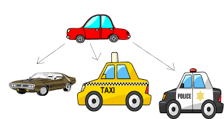
Inherited Car
Think about similarities and differences.

Slide 17
POLYMORPHISM
  Taking more than one form.
  it describes the concept that objects of different types can be accessed through the same interface.
  Same object act’s differently according to the situation.

Slide 18
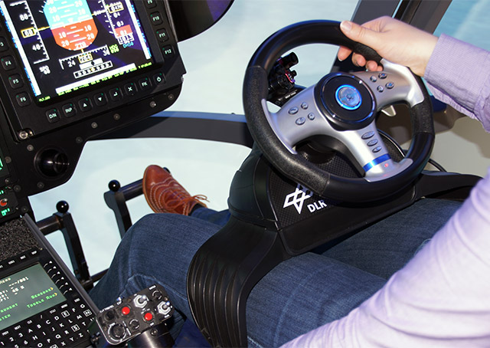
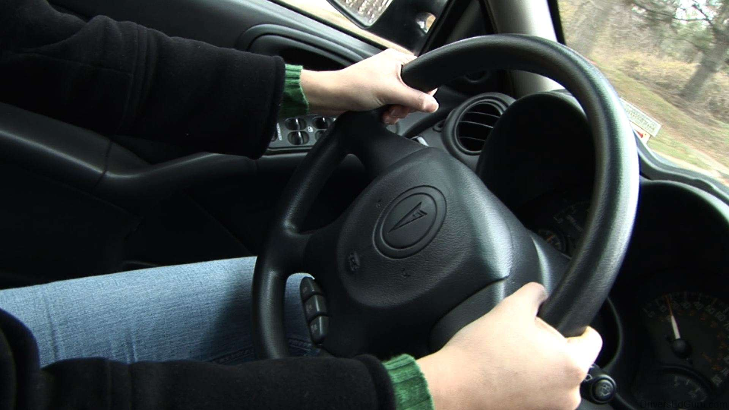
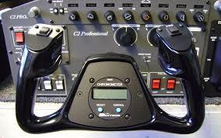
Polymorphic Steer Wheel
[Car vs Aircraft]

Slide 19
Thank You !!!
Rajasekaran S
AP/IT
KGISL Institute of Technology email:proffraja@gmail.com

